Slide 1

smart blood bank management using iot
MINI PROJECT
Presented by : Batch no:08 k. Ramya 21271A0533 k. Roshini 21271A0536 p. Saivinod 21271A0544 k.Sai Rahul 21271A0539
Under the guidance of :
G. Srikanth

Slide 2
Agenda:
Abstract
Introduction
Literature Survey
Problem Statement
Coding and decoding
Results
Existing System
Proposed System
System Requriments
System Design
Conclusion

Slide 3
ABSTRACT:
Blood bank is a place where blood is collected and stored before it is used for transfusions. The main objectives of the blood banks are providing blood to the patients with minimal blood transfusion error. The blood is very important medical supplies so it should be managed well. Traditional blood banks often face challenges such as improper storage conditions, human errors, and lack of real-time information, which can lead to blood wastage, mismanagement, and compromised patient safety. This system addresses these issues by utilizing IoT devices to monitor critical parameters like temperature, humidity, and storage conditions of blood units in real-time. Overall, this Smart Blood Bank Management System improves the safety, efficiency, and transparency of blood bank operations, reduces waste, and enhances the quality of service, making it a vital tool in modern healthcare management.

Slide 4
INTRODUCTION:
Blood is one of the most vital element of the human body.
Normally,7-8% of human body weight is from blood
Function of blood:
-Transporting oxygen and nutrients to our cells
-Rid of carbon dioxide,ammonia,other waste
products
More than 38,000 blood unit required a day
Blood bank is the system being used for storage and preservation of blood and blood constituents which latterly useful for blood transfusion

Slide 5
6 lakh liters (28 lakh units) of blood get wasted in last 5 years
Every year there is a requirement of about 4 crore units of blood, out of which only a meager 40 lakh units of blood found available
There is need of a proper, well connected(microlevel) blood management units to avoid wastage of blood

Slide 6
LITERATURE SURVEY:
The Use of Web Technology and IoT to Contribute to the Management of Blood Banks in Developing Countries
Authors : Ismail, R.D.; Hussein, HA.Salih, M.M.; Ahmed, M.A.; Hameed,Q.A.; Omar, M.B. The Use of Web Technology and IoT to Contribute to the Management of Blood Banks in Developing Countries
Published on : 6 September 2022
Integrated System Development: The study introduces a combined application using Web technology for data management and IoT sensors for real-time temperature monitoring of blood inventory, targeting management issues in blood banks, especially in developing countries
Addressing Key Challenges: It addresses critical challenges such as inadequate blood supply, unstable electricity, and reliance on error-prone manual systems, enhancing the reliability of blood bank operations .
Positive User Evaluation: Feedback from 22 blood bank professionals revealed high satisfaction and effectiveness, indicating that the system significantly improves blood bank management and has strong potential for wider adoption in healthcare.

Slide 7
Smart Blood Bank Management: Urge To Implement IoT For Monitoring and Preventing Blood Bank System Crisis
Authors : Kanna Anil Kumar,gavini chaitanya Sai Kumar,Ajay varma
Published on : April 2024
Integrated Blood Bank Solution: The approach combines web-based technologies and IoT to enhance coordination in blood donation, storage, and distribution, addressing inefficiencies in current systems.
Real-Time Monitoring and Management: It utilizes GSM modules and Arduino microcontrollers for real-time tracking of blood inventory levels, temperature, and location, ensuring optimal storage conditions.
User-Friendly Online Platform: The system features an intuitive online interface for donor registration, appointment scheduling, and inventory management, promoting accessibility and efficiency in blood bank operations

Slide 8
Blockchain-Based Management of Blood Donation
Authors : Diana Hawashin,Dunia Amin j.Mahboobeh,khaled salah,Raja JayaRaman
Published on : December 8th 2021
Blockchain-Based Solution: The paper proposes a private Ethereum blockchain solution for blood donation management, addressing shortcomings in traceability, transparency, and security while eliminating the risks of centralization.
Decentralized Storage: Non-critical and large data are stored off-chain using the InterPlanetary File System (IPFS), enhancing efficiency and scalability while maintaining privacy and security.
Comprehensive System Design: The paper includes detailed system architecture, sequence diagrams, and algorithms, alongside performance evaluations and a publicly available smart contract code on GitHub, demonstrating the solution's effectiveness and security

Slide 9
PROBLEM IDENTIFICATION:
The current approach involves paper-based records and fragmented storage, which leads to inefficiencies in search and retrieval of critical information.
monitor and adjust the conditions of blood storage units remotely to ensure 24/7 compliance with safety standards
Currently manual entry (log) is in use.
Absence of centralized database system
In case of emergency, its really tedious to look for a specific blood sample
There is an absence of “ALERT” system present for acknowledgement
To Design Smart blood bank management system based on IoT.

Slide 10
EXISTING SYSTEM:
In the present scenario, many people were facing a lot of problems in getting blood for patients at right time.
The needy does not know where to get the blood or how to get access to a required quantity of blood quickly in an emergency.
Traditional blood donation systems often rely on manual processes for donor registration, blood collection, testing, and distribution. While these systems have been effective to some extent, they face challenges such as inefficiency, lack of real-time data tracking, and limited accessibility for donors and blood bank

Slide 11
PROPOSED SYSTEM:
The proposed system is a Smart Blood Bank Management System using IoT technology to ensure the safe storage and handling of blood products. It utilizes sensors to monitor key factors such as the weight, temperature, and humidity of blood bags and the storage environment.
The weight sensor helps track the amount of blood in each bag, while the temperature sensor ensures that the blood is stored within the required range (typically 2-6°C) to maintain its viability. Humidity levels are also monitored to prevent environmental conditions that could damage the blood bags or equipment.
The system sends this data to ThingSpeak, a cloud platform, where it is logged, analyzed, and made accessible to authorized personnel for real-time monitoring and management. Alerts are triggered if the temperature or humidity falls outside the acceptable range, allowing for quick intervention. Additionally, the system aids in inventory management by tracking the weight of the blood bags, ensuring accurate stock levels.
Overall, this IoT-based system enhances the efficiency, safety, and reliability of blood bank operations by providing continuous, remote monitoring and real-time alerts, helping to maintain the quality and availability of blood products.

Slide 12
SYSTEM REQUIREMENTS:
Hardware Requriments :
Hardware interfaces specify the logical characteristics of each interface between the software product and the hardware components of the system. The following are some hardware requirements.
Arduino
Hx711 Sensor
DHT11 Sensor
ESP01( Wifi module)

Slide 13
SOFTWARE REQUIREMENTS:
Software Requirements specifies the logical characteristics of each interface and software components of the system. The following are the software requirements
Operating System : Windows 11
Arduino Ide and ThingSpeak

Slide 14
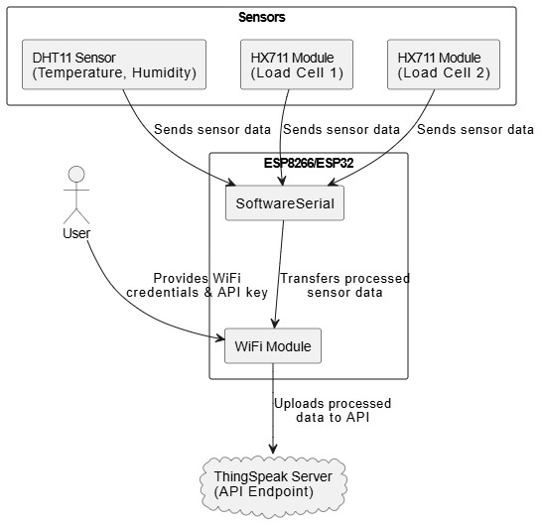
System architecture:

Slide 15
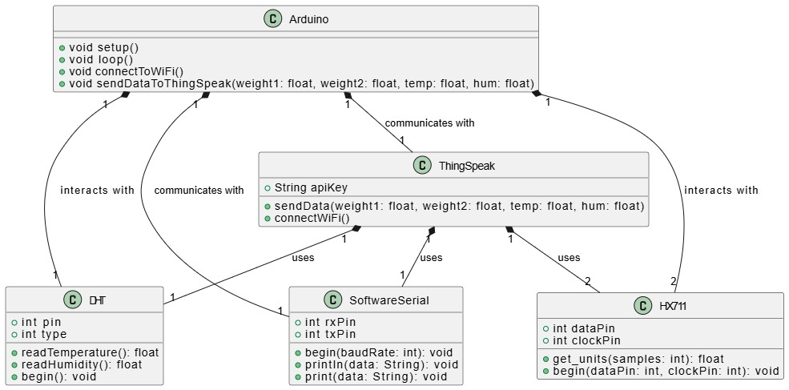
Class diagram:

Slide 16
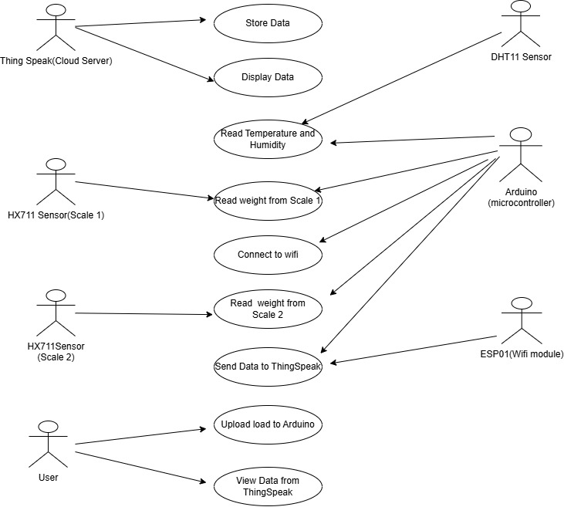
Usecase diagram:

Slide 17
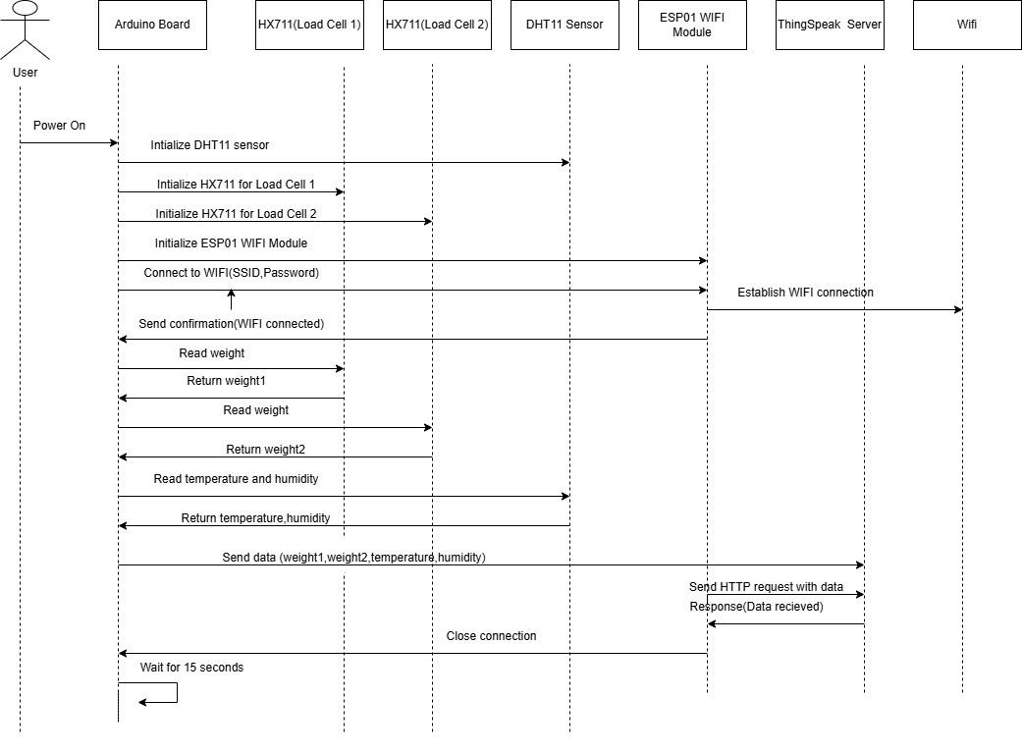
Sequence diagram:

Slide 18
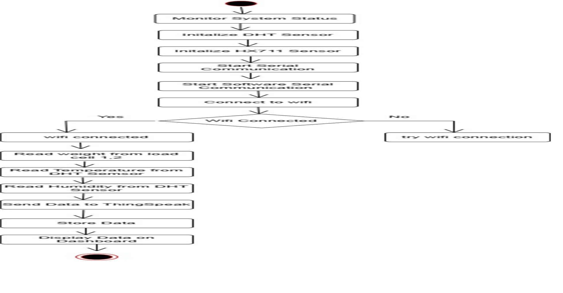
Activity diagram:

Slide 19
Coding & testing:
Use MQTT protocol to receive real-time sensor data (temperature, humidity, blood type).Store data in an SQLite database for persistent storage.
IoT Data Ingestion and Storage:
Define safe ranges for temperature (2–8°C) and humidity (40–60%).Create a function to detect out-of-range values and generate alerts.
Anomaly Detection:
Use historical data (blood_demand.csv) for demand forecasting by blood type.Train a time-series model (e.g., Linear Regression or ARIMA) to predict future demand.
Demand Prediction:
Unit Testing:
Test core functions like anomaly detection and email alerting.Validate the storage of sensor data in the database.

Slide 20
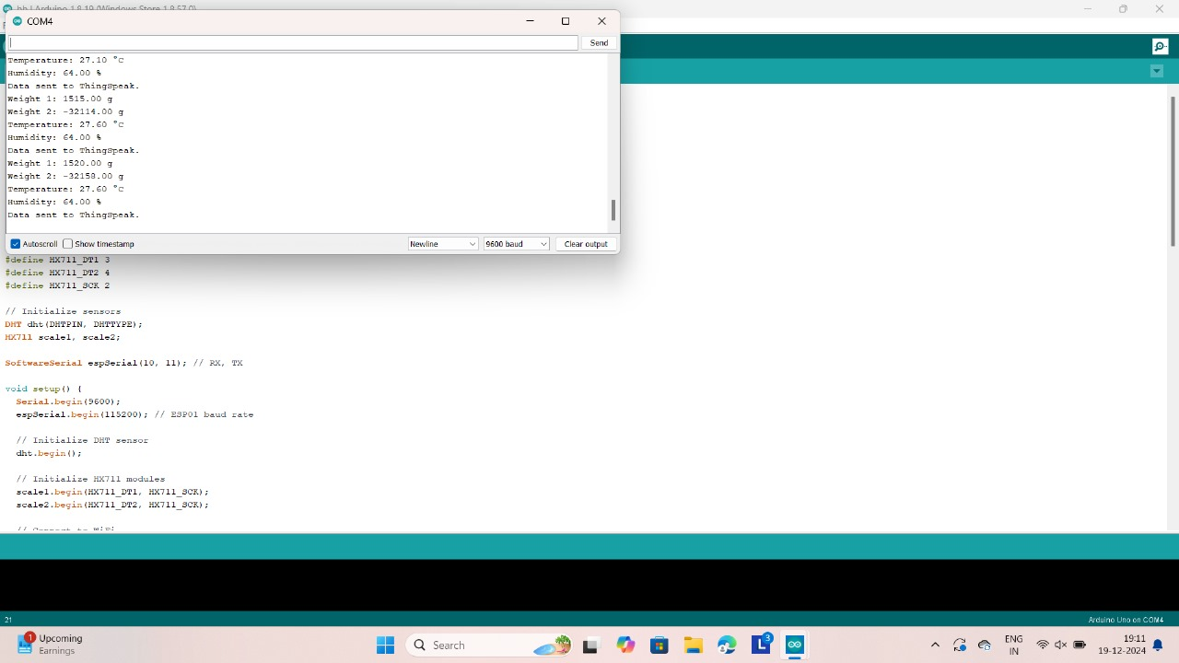
Result:

Slide 21
Result analysis:
In a smart blood bank management system using IoT, It plays a vital role in ensuring the safe storage and management of blood and related products. The weight reading represent the weight of blood bags, helping track inventory levels and ensuring proper management of the blood supply. However, the negative weight value indicates a sensor malfunction, which requires immediate attention to prevent erroneous data from affecting operations.
The temperature reading of 26.20 °C is important, as blood must be stored within specific temperature ranges to maintain its viability, and any deviations could trigger an alert to prevent spoilage. Similarly, the humidity level is monitored to ensure the overall environment remains stable, particularly for sensitive items that may require controlled humidity levels.
Lastly, the "Connected to WiFi" status enables real-time data transmission, remote monitoring, and automated alerts, ensuring that any irregularities, such as temperature fluctuations or low stock levels, are promptly addressed. Together, these readings help maintain optimal storage conditions, prevent spoilage, and ensure the blood bank is well-managed and ready to meet medical needs, though the sensor issues with weight data need to be resolved for accurate operation.

Slide 22
Conclusion:
In conclusion, a Smart Blood Bank Management System leveraging IoT transforms traditional processes by improving efficiency, accuracy, and accessibility. Real-time monitoring and automated data management enhance tracking of blood stocks, reducing wastage and preventing shortages. IoT-enabled sensors continuously monitor storage conditions, ensuring the safety of stored blood. This system streamlines donor management and coordination between hospitals and blood banks, ultimately ensuring timely availability of safe blood and enhancing overall healthcare quality.

